Slide 1




My Algebra Interactive Notebook
$$3ab$$
$$2x+3y$$
$$\frac{5xy}{6}$$
Name :
Class :
Term 2 Semester 1
$$y=2x+1$$

Slide 2
Contents
Glossary
Page
Date
Description
2
3

Slide 3
Tasks
24
7
30
Essential Question
Questions
Notes
Summary
4
5

Slide 4
Group Activity- Fraction Connectors
In groups of 3 or 4, cut out the four main numbers and arrange them as below
12
18
36
60
Notes:
Set

Slide 5
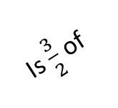
Group Activity- Fraction Connectors
Next, you have 5 minutes to place as many of the arrows in between these numbers so the mathematical sentence they make is true
12
Is $\frac{3}{2}$ of
36
18
GO!
60
Notes:
Set

Slide 6
24
7
30
Date
Equivalent Fractions
EQ – How do you make equivalent fractions?
5
Notes:
Input

Slide 7
24
7
30
Date
Equivalent Fractions
EQ – How do you make equivalent fractions?
What are equivalent fractions?
5
Notes:
Input

Slide 8
24
7
30
Date
Equivalent Fractions
EQ – How do you make equivalent fractions?
What are equivalent fractions?
Equivalent fractions are equal to each other. They have the same value but each have a different denominator.
5
Notes:
Input

Slide 9






24
7
30
Date
Equivalent Fractions
EQ – How do you make equivalent fractions?
What are equivalent fractions?
Equivalent fractions are equal to each other. They have the same value but each have a different denominator.
$$\frac{1}{2}$$
$$\frac{1}{2}$$
$$\frac{1}{4}$$
$$\frac{1}{4}$$
e.g. $\frac{1}{2}= \frac{2}{4}$
$$\frac{1}{4}$$
$$\frac{1}{4}$$
5
Notes:
Input

Slide 10
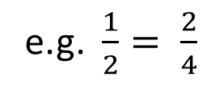



24
7
30
Date
Equivalent Fractions
EQ – How do you make equivalent fractions?
What are equivalent fractions?
Equivalent fractions are equal to each other. They have the same value but each have a different denominator.
$$\frac{1}{4}$$
$$\frac{1}{4}$$
e.g. $\frac{1}{2}= \frac{2}{4}$
$$\frac{1}{2}$$
$$\frac{1}{2}$$
$$\frac{1}{4}$$
$$\frac{1}{4}$$
Why do we need to make equivalent fractions?
So that we can add and subtract fractions or so we can find the simplest version of that fraction to help us understand.
How much of a pizza would you prefer to eat? $\frac{1}{4} or \frac{4}{12}$
5
Notes:
Input

Slide 11
24
7
30
Date
Equivalent Fractions
EQ – How do you make equivalent fractions?
What are equivalent fractions?
Equivalent fractions are equal to each other. They have the same value but each have a different denominator.
$$\frac{1}{4}$$
$$\frac{1}{4}$$
e.g. $\frac{1}{2}= \frac{2}{4}$
$$\frac{1}{2}$$
$$\frac{1}{2}$$
$$\frac{1}{4}$$
$$\frac{1}{4}$$
Why do we need to make equivalent fractions?
So that we can add and subtract fractions or so we can find the simplest version of that fraction to help us understand.
How much of a pizza would you prefer to eat? $\frac{1}{4} or \frac{4}{12}$
How do you make fractions equivalent?
You multiply/divide the numerator (top) and denominator (bottom) by the same number.
5
Notes:
Input

Slide 12



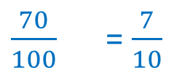
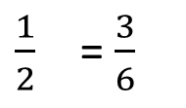
24
7
30
Date
Equivalent Fractions
EQ – How do you make equivalent fractions?
What are equivalent fractions?
Equivalent fractions are equal to each other. They have the same value but each have a different denominator.
$$\frac{1}{4}$$
$$\frac{1}{4}$$
e.g. $\frac{1}{2}=\frac{2}{4}$
$$\frac{1}{2}$$
$$\frac{1}{2}$$
$$\frac{1}{4}$$
$$\frac{1}{4}$$
Why do we need to make equivalent fractions?
So that we can add and subtract fractions or so we can find the simplest version of that fraction to help us understand.
How much of a pizza would you prefer to eat? $\frac{1}{4} or \frac{4}{12}$
How do you make fractions equivalent?
You multiply/divide the numerator (top) and denominator (bottom) by the same number.
×3
÷2
÷5
$\frac{1}{2}$ = $\frac{3}{6}$
÷10
$\frac{14}{20}$ = $\frac{7}{10}$
$\frac{35}{50}$ = $\frac{7}{10}$
$\frac{70}{100}$ = $\frac{7}{10}$
×3
÷10
÷2
÷5
5
Notes:
Modelling

Slide 13
24
7
30
Date
Equivalent Fractions
EQ – How do you make equivalent fractions?
What are equivalent fractions?
Equivalent fractions are equal to each other. They have the same value but each have a different denominator.
$$\frac{1}{4}$$
$$\frac{1}{4}$$
e.g. $\frac{1}{2}=\frac{2}{4}$
$$\frac{1}{2}$$
$$\frac{1}{2}$$
$$\frac{1}{4}$$
$$\frac{1}{4}$$
Why do we need to make equivalent fractions?
So that we can add and subtract fractions or so we can find the simplest version of that fraction to help us understand.
How much of a pizza would you prefer to eat? $\frac{1}{4} or \frac{4}{12}$
How do you make fractions equivalent?
You multiply/divide the numerator (top) and denominator (bottom) by the same number.
×3
÷2
÷5
$\frac{1}{2}$ = $\frac{3}{6}$
÷10
$\frac{14}{20}$ = $\frac{7}{10}$
$\frac{35}{50}$ = $\frac{7}{10}$
$\frac{70}{100}$ = $\frac{7}{10}$
×3
÷10
÷2
÷5
*Some tricks for simplifying*
Lose the zeros
Half it
Divide by HCF
5
Notes:
Modelling

Slide 14
Remember!

Slide 15
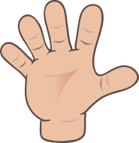
Do you understand? Fists of Five
Notes:
Check for Understanding

Slide 16
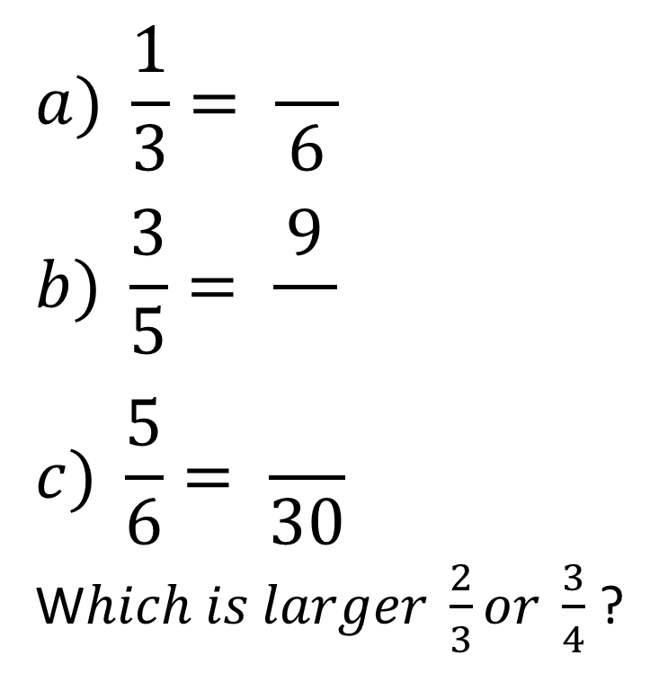
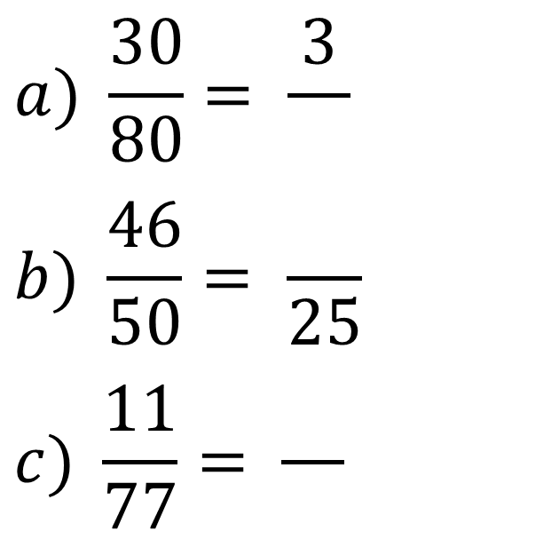
Let’s try these together
Getting bigger Getting smaller
$$a) \frac{1}{3}= \frac{}{6}$$
$$b) \frac{3}{5}= \frac{9}{}$$
$$c) \frac{5}{6}= \frac{}{30}$$
W$hich is larger \frac{2}{3}or \frac{3}{4}$ ?
$$a) \frac{30}{80}= \frac{3}{}$$
$$b) \frac{46}{50}= \frac{}{25}$$
$$c) \frac{11}{77}= \frac{}{}$$
Notes:
Guided Practice

Slide 17
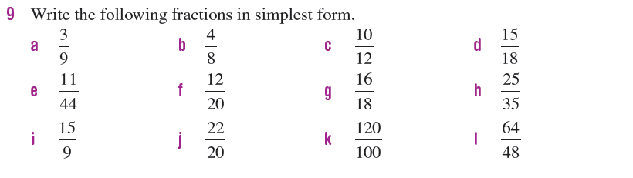
Task
Notes:
Independent Practice

Slide 18

Final challenge!
Find as many equivalent fractions for $\frac{50}{100}$ as you can in one minute
Notes:
Closure

Slide 19

Final challenge!
Find as many equivalent fractions for $\frac{50}{100}$ as you can in one minute
Compare them with your neighbour. Cross off any you both got. How many unique ones did you get?
Notes:
Closure

Slide 20
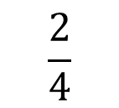
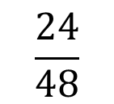
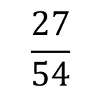
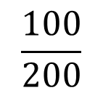
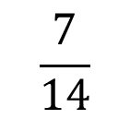
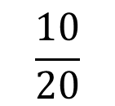
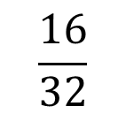
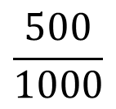
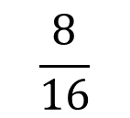
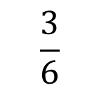
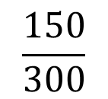
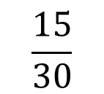
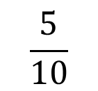
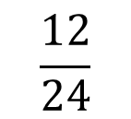
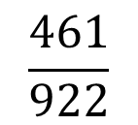
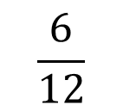
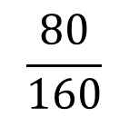
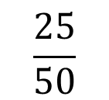
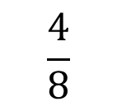
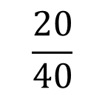
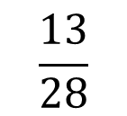
$$\frac{5}{10}$$
$$\frac{25}{50}$$
Here are some of mine. How did I go?
$$\frac{100}{200}$$
$$\frac{10}{20}$$
$$\frac{2}{4}$$
$$\frac{4}{8}$$
$$\frac{6}{12}$$
$$\frac{16}{32}$$
$$\frac{15}{30}$$
$$\frac{24}{48}$$
$$\frac{12}{24}$$
$$\frac{150}{300}$$
$$\frac{8}{16}$$
$$\frac{500}{1000}$$
$$\frac{20}{40}$$
$$\frac{27}{54}$$
$$\frac{80}{160}$$
$$\frac{3}{6}$$
$$\frac{7}{14}$$
$$\frac{13}{28}$$
$$\frac{461}{922}$$
Notes:
Closure

Slide 21
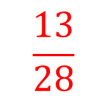
$$\frac{5}{10}$$
$$\frac{25}{50}$$
$$\frac{100}{200}$$
$$\frac{10}{20}$$
$$\frac{2}{4}$$
$$\frac{4}{8}$$
$$\frac{6}{12}$$
$$\frac{16}{32}$$
$$\frac{15}{30}$$
$$\frac{24}{48}$$
$$\frac{12}{24}$$
$$\frac{150}{300}$$
$$\frac{8}{16}$$
$$\frac{500}{1000}$$
Did you spot the error?
$$\frac{20}{40}$$
$$\frac{27}{54}$$
$$\frac{80}{160}$$
$$\frac{3}{6}$$
$$\frac{7}{14}$$
$$\frac{13}{28}$$
$$\frac{461}{922}$$
Notes:
Closure

Slide 22
Notes Review
24, 7 ,30
Date
Title
Essential question
Notes complete
Notes complete with colour and diagrams
Questions completed
Contents page filled in
Formula page filled in

Slide 23
Homework
Review your notes and write a summary answering the essential question.

